Slide 1
Binary Search Tree
by Joel, Zohaib, Isaac, Brett

Slide 2
Binary Search Tree
Also known as ordered or sorted binary
A binary tree is a finite set of nodes which is either empty or consists of a root and two disjoint binary trees called the left subtree and the right subtree.

Slide 3
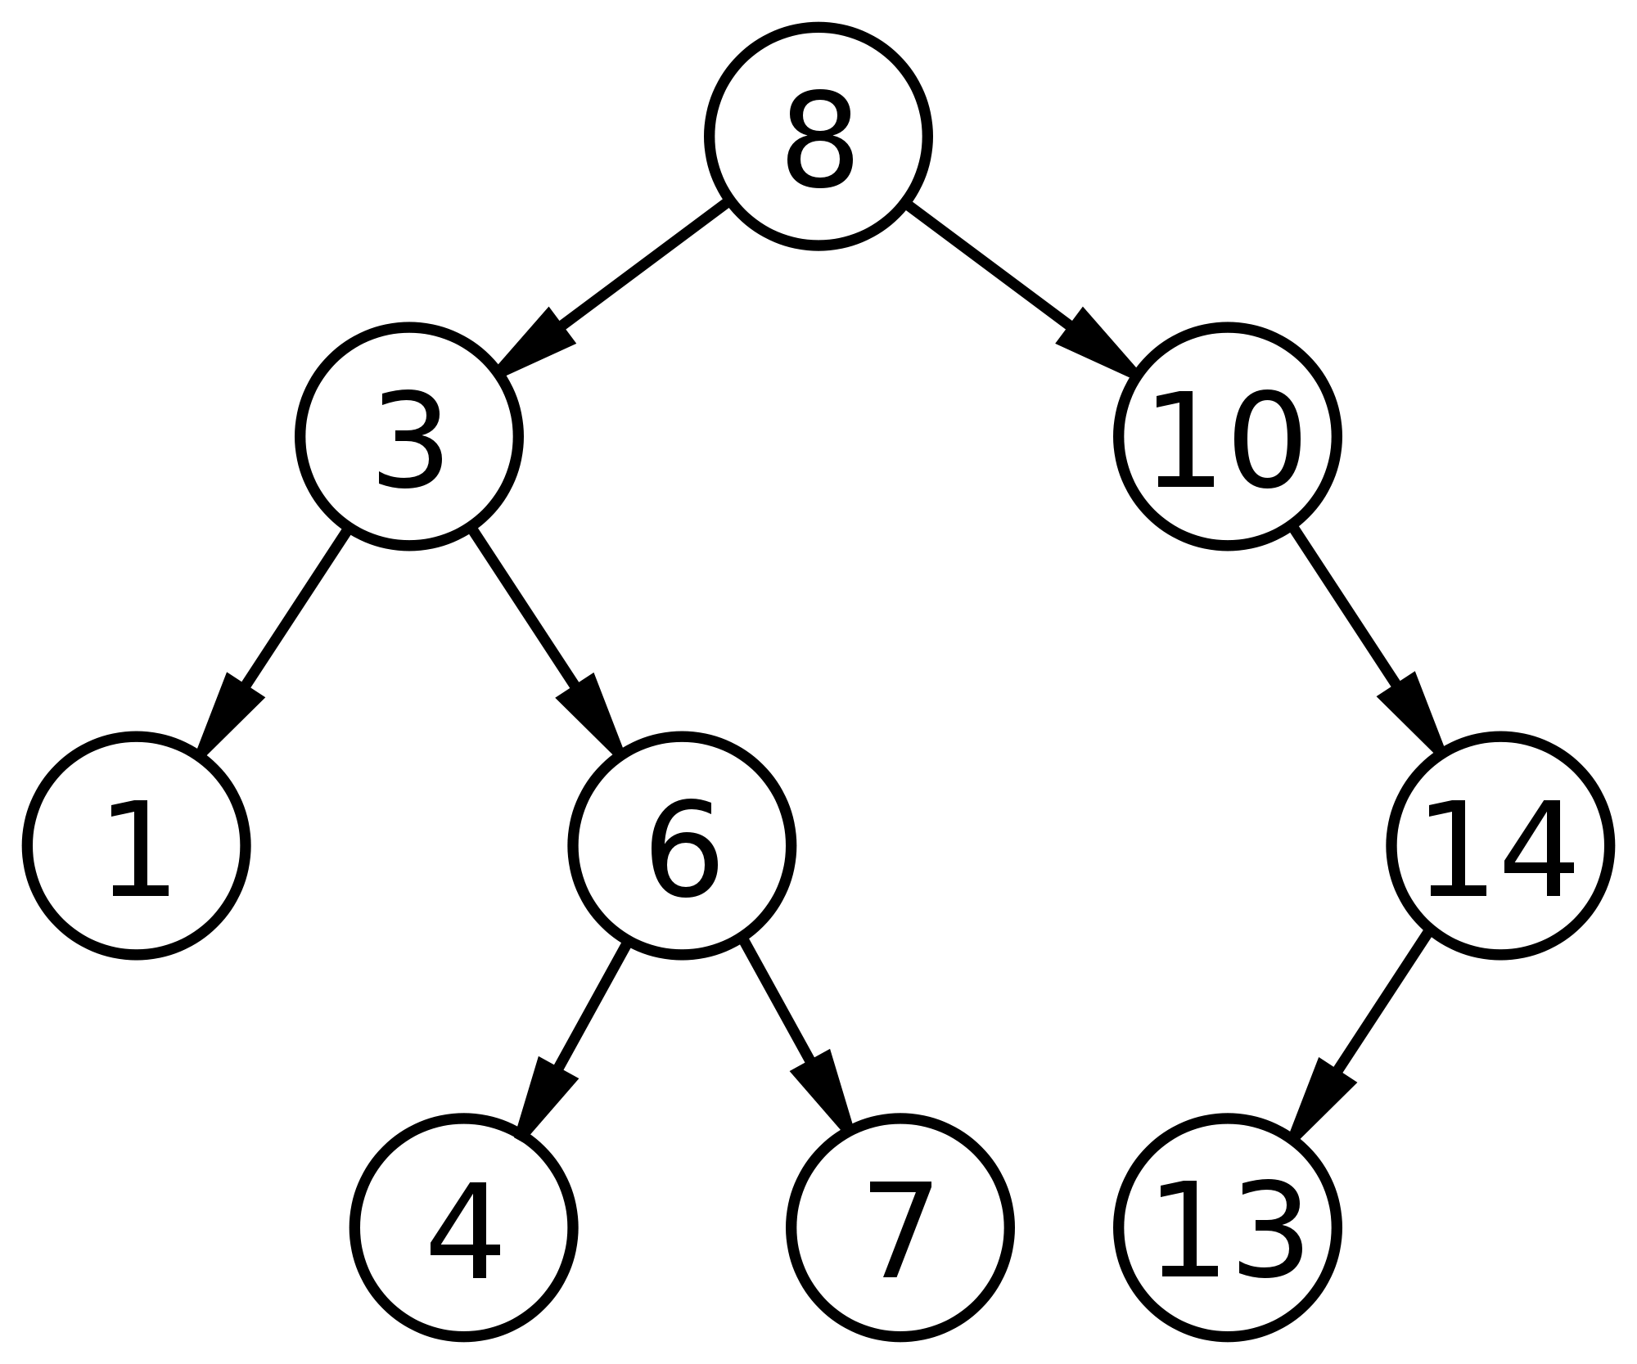
Nodes
All nodes have a key(value)
The root node is the top node of the tree
Only have a maximum of two children
A Child can only have one Parent
The left Child must be less than the key of the parent node
The Right Child must be greater than or equal to the key of the parent node
Every node should have a subnode on the left and the right

Slide 4
Characteristics
A Leaf node has no child nodes
an Interior node has at least one child node.
All nodes can be accessed through root reference by recursively accessing the left or right child nodes.
when you want to end the tree reference the left and right node as null.

Slide 5
Adding Nodes
Start at the top of the tree
Adds the node by comparing if the node you’re adding is less/greater than the node it is comparing
works its way down until an empty spot is found (when FocusNode == null)

Slide 6
Deleting Nodes
2 things to do
Remove the reference of the node from its parents
Wipe off the node being deleted from memory
3 Cases when Deleting

Slide 7
Case 1: No Children
When the node has no children
Fairly simple to do
Just delete the reference to that node
Binary Tree is still functional

Slide 8
Case 2 : Left Child Only
Occurs if the Node you want to delete has only One child
Check if the Node is a Left or Right Child to its Parent
If LeftChild:
Set the Node’s (you want to delete) parent LeftChild as the Node’s LeftChild
If RightChild:
Set the Node’s (you want to delete) parent RightChild as the Node’s LeftChild

Slide 9
Case 2 : Right Child Only
Occurs if the Node you want to delete has only One child
Check if the Node is a Left or Right Child to its Parent
If LeftChild:
Set the Node’s (you want to delete) parent LeftChild as the Node’s RightChild
If RightChild:
Set the Node’s (you want to delete) parent RightChild as the Node’s RightChild

Slide 10
Case 3: Two Children
Find minimum in the right-Subtree
Copy the value into targeted node
Delete the duplicate in the right-Subtree
OR
Find maximum in left-Subtree
Copy the value into targeted Node
Delete the duplicate in the left-Subtree

Slide 11
Introduction to Traversal
Means to visit the root node and traverse its children. Visiting a node usually involves collecting data from it.
Three different types : Inorder, Preorder and Postorder

Slide 12
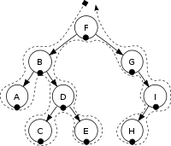
In-Order Traversal
This can be summed up as
Traverse to left subtree until you reach the end
Visit root node (generally output this)
Traverse to right subtree
And outputs the following: A, B, C, D, E, F, G, H, I
For sorted binary trees it will output the nodes in order (alphabetical above).

Slide 13
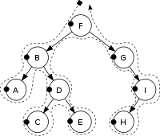
PreOrder Traversal
This can be summed up as:
Visit the root node (generally output this)
Traverse to left subtree
Traverse to right subtree
And outputs the following: F, B, A, D, C, E, G, I, H

Slide 14
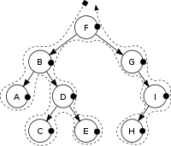
PostOrder Traversal
This can be summed up as:
Traverse to left subtree
Traverse to right subtree
Visit root node (generally output this)
And outputs the following: A, C, E, D, B, H, I, G, F

Slide 15
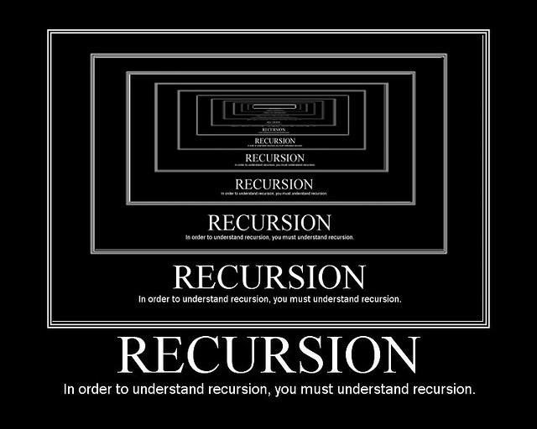

Searching
There are 2 methods of searching in Binary Search Tree :
1) Recursively 2) Iteratively

Slide 16
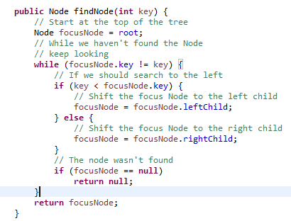
Iterative - Search
start by comparing the key that you are trying to find with the root node
when key is bigger, search from the left side
when key is smaller, search from the right side
same principle is used until you find the key that you are looking for
if null is reached, the key is not present in the tree

Slide 17
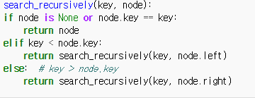
Recursive - Search

Slide 18
Search

Slide 19
Why Use Trees?
You can search, and insert/delete items quickly in a tree
Queue and Stack methods are bad at insertion/Deletion
Time needed to perform a search, insert, deletion on a tree is O(log N)
Tree is more efficient in finding items compared to Linked Lists such as Queue or Stack.

Slide 20
Applications of binary search tree
Used in many search applications where data is constantly entering/leaving, such as the map and set objects in many languages' libraries.
Quick Searching. A balanced binary search tree is very fast in finding items
Routing Tables, for routers that need to be extremely fast.

